Slide 1
TRAINING
OUTLINE
CI Orientation Program
Section 1 - Who we are?
Section 2 - What we do and how we do it?
Section 3 - Our philosophy
Section 4 - Our design process
Section 5 – What is Visual Design
Section 6 - Life beyond designing
Section 7 – Our recent works

Slide 2
Who we are?

Slide 3

1
Who we are| Organization overview
Interactive Design
Interactive Learning
Interactive Content
Learning Design & Development
Learning production & management
Learning Transformation
Full Service Documentation Management
Online Content
Product Documentation
LOB
Competency
EBA
Digital Channels
Analytics
Digital production
Corporate
Interaction Design
Visual Design
Web & RIA Development
Analytics
LOB : Lines of Business

Slide 4
1
Who we are| Organization overview
1500+ member strong global talent pool designing world class User Experience solutions across technology platforms.
We are one of the largest Design Services groups in the industry, helping our clients create end-to-end value throughout the customer lifecycle and to deliver a Data-driven Multi-screen Digital Experience.
Consultants (150+) Digital Strategists UX Analysts (Domain/Technology) Information Architects Digital Analytics & Marketing Experts Creative Directors Social Media Experts
Designers (300+) Interaction Designers Mobile Designers Visual Designers Flash Designers Production Singers Print design specialists
UI Developers (850+) Web Developers Flex Programmers Flash/Scripting Programmers RIA Technology architects Accessibility experts
Analytics & Marketing (100+) Analytics Tools Experts Reporting & Insights Experts SEO/SEM Experts
Key Differentiators
One-stop-shop for integrated UX Design, Development and Measurement services
Experience across front-end technologies
Leverage design experience and best practices from different domains
Recent works got featured in CBS News, Nominated for Webby Awards
SMEs with over 10 years hands on industry experience
Experienced in seamlessly collaborating in a multi-disciplinary and multi-vendor environment
Industry known “Two-in-the-box” model

Slide 5
What we do & how we do it?

Slide 6
2
What we do & how do we do it | Overview
Creative Design (Static and Interactive assets)
Creative asset production, support and maintenance
Product tours and Demos (Flash-based)
Banners / posters
Presentations
Logos
Marketing material
Mailers
Creative design support
Content Publishing Services (Websites, Intranets & Portals)
Development (design/strategy provided by client/agency)
Maintenance / Support
Migrations
Porting sites to mobile platforms
Accessibility compliance
Converting presentations to HTML5
UI Testing
Content Visual QA
Content Textual QA
Content Code Testing
Accessibility Compliance Testing
Engagement Models
Long term SLA/Program governance models
Managed Services
Ticketing Services
Development Maintenance & Support
Creative Maintenance & Support

Slide 7
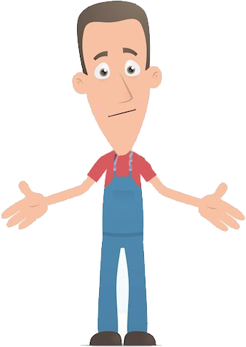
What we do & how do we do it | Why we are here?
2
We gather requirements from our clients
We analyze the requirement and create Information architecture and wireframe
We research and do competition analysis
We think & do brain storming, trend setting, decide on color palette
We scribble our ideas
The last thing we do is “Design”.

Slide 8
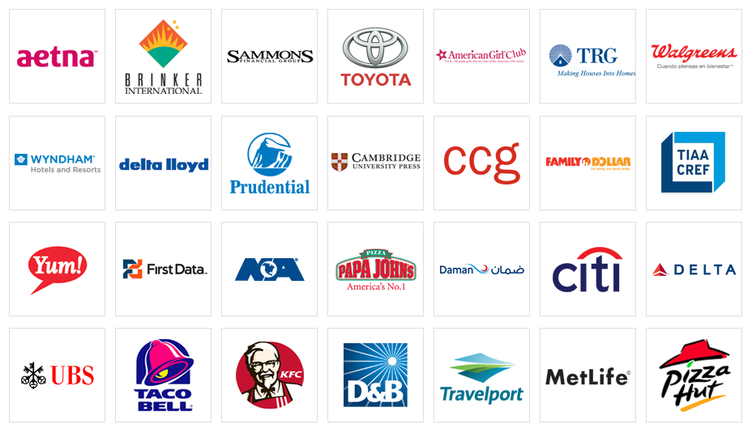
What we do & how do we do it | For whom we provide design solutions?
2
Our client list includes:
Fortune 500 companies | World-renowned insurance providers and financial institutions | Top of the line retail chains | Travel and Tourism giants

Slide 9
Our philosophy

Slide 10

Our philosophy | Our motto
3
“Every employee should feel that he or she is contributing to something that will actually make a genuine and positive difference in the lives of customers and colleagues.”

Slide 11
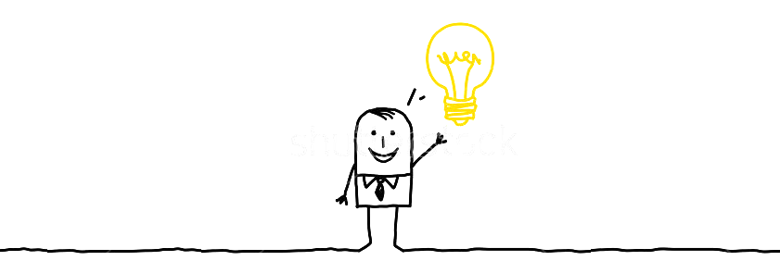
Our philosophy | Our belief
3
OUTSIDE
INSIDE
The market
The competition
The numbers
The client
Purpose comes from the inside

Slide 12
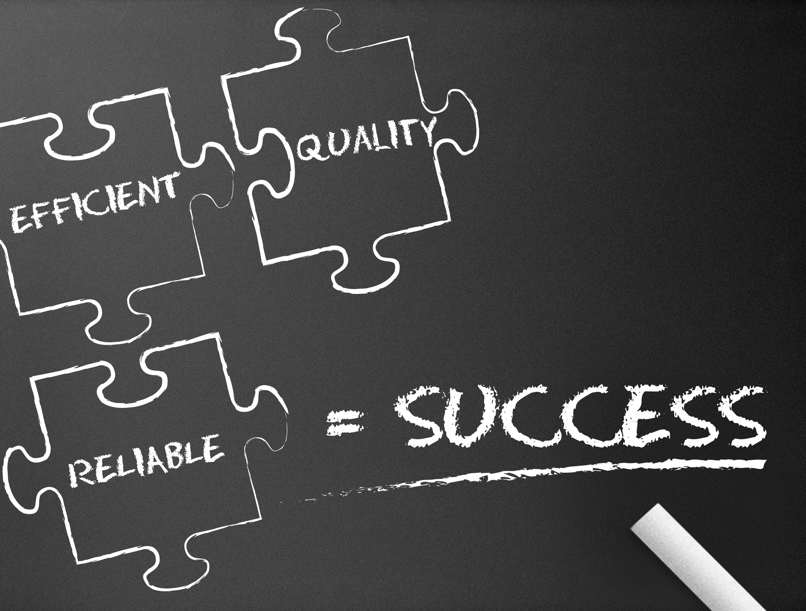
Our philosophy
3
Don’t just design. Think.
Don’t Just think. Validate.
Don’t just validate. Implement.
Don’t just implement. Make it perfect.

Slide 13
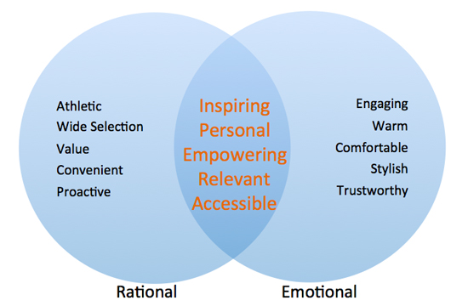
Our philosophy | What we offer?
3
We offer “Solutions”. Not just designs!
When does the magic happen?
When your work has right balance Rational & Emotional Quotient.

Slide 14
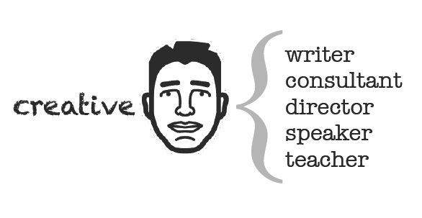
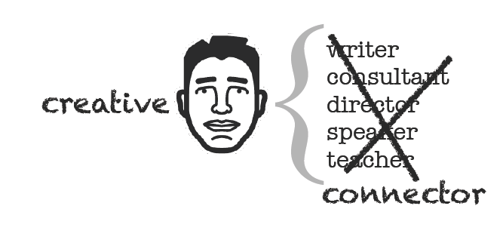
Our philosophy | What do we think about ourselves?
3

Slide 15
Our design process

Slide 16
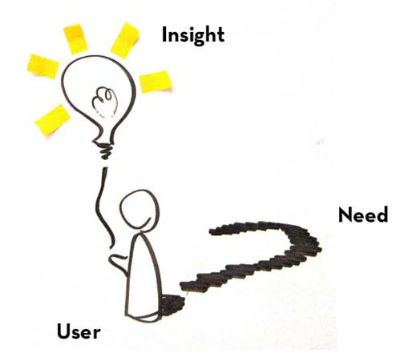
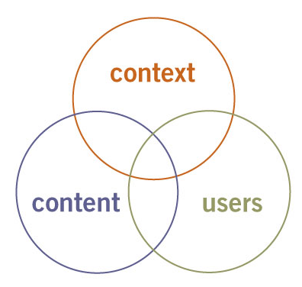
Our design process
4

Slide 17
What is Visual Design

Slide 18

What is Visual Design
5
Communicating through Design
Communication is a variety of behaviors, processes, and technologies by which meaning is transmitted or derived from information.
The first communication that human had was visual communication drawn in caves even before the discovery of language.
The subject includes Graphic Design, Illustration and Animation for; books, print, magazines, screen-based media, interactive web design, short film, design for advertising, promotion, corporate identity, packaging design & more.
Visual Communication is the conveyance of ideas and information in forms that can be read or viewed.

Slide 19

What is Visual Design
5
We go on many places like our favorite store, our favorite person or even our favorite website. But sometimes we create an emotional relation with any one of them. It also applies in the field of web page designing. If your design is creative and engaging, the visitor prefers to come again and again on this site. That is how a designer communicate with the help of design.
A Boundary across which two independent systems meet and act on Communicate with each other

Slide 20
What is Visual Design| Visual Design Process
5
Revised concept
Research & Requirements Gathering
Design Implementation
Concept Generation
Prototyping
Activities
Testing/Feedback
Stakeholder Interviews
Research - Client Branding material, existing artworks, URL’s, other Products if any, Competitors sites & branding materials,
Visual Design Review
Pencil Sketches
Concept Generation based on creative brief document
Update concept based on client feedback
Brand Perception Test
Apply finalize visual language to internal screens
Design Specification
HTML Pages
Graphic Slices
Internal Output
Questionnaire Document
Client Deliverables
Client Deliverables
Client Deliverables
Client Deliverables
Visual Design Review
Internal screens
Specifications Doc
Creative brief Document
Visual Design Concepts
HTML Page Types
Brand Perception Test doc

Slide 21
What is Visual Design| Why Process
5
Provide:
Parameters to evaluate visual design
Scientific approach towards art
Buy-in on every step from client so less chances of re-re work
Consistent and quality deliverables

Slide 22
What is Visual Design| Offerings/ Opportunities
5
Visual Design Review (Static / Interactive)
Concept Sketches
Icon Design
Standards and Guidelines
Logo Design
Flash Graphics – Interactive banners, Demo etc.
Improve the user experience in:
Websites / Web Applications/ Portals
Mobile / iPad Interfaces
Software Products
Physical Interfaces

Slide 23
Life Beyond Designing

Slide 24
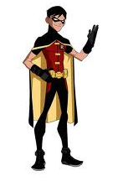
Life Beyond Designing
6
Your behavior & communication is as important as your skill.
Always communicate what you think, what you want to do and how your perceive things.
Follow proper channels to communicate.
Be creative! That’s the primary reason you are here!
Act
Encourage
Creative
Communicate
Share
Respect
Lead
Plan
Initiative
Ask
Responsible
Learn
Follow

Slide 25
Our design process | Challenges & Opportunities
6
You grow as we grow| Your contribution matters
Your contribution is important.
Prepare yourself for the global platform. Your work will be noticed!
Know the latest in Technology and Trends.
Remember 3P’s “Perception, Perfection & Packaging”.
Got noticed? Document it.
Archive all the appreciation mails in proper folder.
Always send a copy of appreciation mails to your supervisor.

Slide 26

Life Beyond Designing
6
Arrange | It’s not how good you are, it’s how good you want to be!
Arrange and document:
Arrange every artifacts in proper folder structure.
Arrange project related emails in proper folder.
Learn from your peers:
Folder arrangement that is already in process.
The grouping standards which is being practiced.
Collaborate: Work in a manner where multiple team/people will work on the same file. Maintaining proper structure is important. Create design documentation and style guide where necessary.
Archive: Once the project is over, create an archive folder and put all the unused or older versions. The final deliverables should be kept in a separate folder.
Update: Always make it a habit to update your latest resume, profile and portfolio following CI templates. Ask your supervisor for the latest templates.

Slide 27

Life Beyond Designing
6
Leave | Plan Early. Spend lovely!
Plan: Plan early. Apply for leave. Check whether leave is approved.
Inform:
Inform your project manager and supervisor in case of sudden leave.
Remind your project manager and supervisor again before your planned leave date.
Communicate: Leave your communication address/phone no. to your project colleagues & HCM Manager.
Update: Update your latest contact details in HCM so that people can reach you in need.
Respond: Respond if something is urgent.

Slide 28


Life Beyond Designing
6
Timesheet | It’s you & Your work. Documented!
Be regular: Fill up the timesheet on a regular basis. You and your department loses man-hour if you don’t fill up timesheet.
Be aware: Make sure your project does not have any separate timesheet. Some accounts have their own timesheet apart from Cognizant timesheet.
Be time-proof: Fill up the timesheet before going on a vacation.
Be responsive: In case of any confusion/clarification ask your HCM Manager before submitting the timesheet.

Slide 29

Life Beyond Designing
6
Escalation | It’s time to act!
What is it? Escalation is a written complaint/concern against your work/you.
Why? Escalation often happens because people fail to communicate the actual work status on a timely manner.
What to do?
Be calm. Analyze the situation but do not sit idle. It’s time to act.
Do not take any action/write mails till you discuss the matter with your supervisor/HCM Manager.
How to prevent? Be responsible. Be responsive. Set clear expectations and deliver in a timely manner.

Slide 30

Life Beyond Designing
6
E-Mail Etiquette | The Do’s and Don’ts
What matters? It’s not how good your language is. It’s how good you communicate.
What not to do? Do not forward junks. Respect people’s time and company’s bandwidth.
How to share?
Share learning in proper DL(Distribution List)/groups.
Do not use “reply to all” button until necessary.
Email expectations:
You are supposed to check all mails before deleting the unnecessary ones. Make sure none of the important messages gets deleted/ goes to spam.
Create separate email folders for projects. It’ll be easy to track updates.
Making a habit to check all mails before you leave for the day always helps.

Slide 31

Life Beyond Designing
6
Know your Role| Act on them
Know your goals. As an associate, you have certain goals ( which are set via HCM) and certain expectations which are set by your supervisor.
Know your role. If you are not sure, ask your supervisor.
Your contribution matters: Each and every associate and their contribution is important for growth.
Ask for feedback. It always helps.
Express your opinion through proper channel.

Slide 32

Life Beyond Designing
6
Presentation| Never “Send” your design. “Present” it.
Document your design: When you are done with a design, create a justification document on how you have perceived the design and how others should perceive it. It can be in the form of a mail, word doc or power point deck or flash.
Present your design: Presentation should be neat and should include business understanding, focus group/target audience and how our solution is aligning with the requirement. In some case detailed understanding of how we approached the problem and where from we drew our inspiration can also be required.
Be creative with your presentations. Remember, although you can get hint or template from the previous project presentations, as every requirement/design is unique the solution approach is also different. Be creative, use your own method of explaining which covers all of the above aspects.
Present personally. If it’s possible or the situation demands, be prepared to present your design over call or Video Conferencing.

Slide 33



Useful Contact No.s
6
Important Contact No.s| Keep them handy. They saves life at times!
Organization Level:
Local Admin
GSD NSS
Transport Helpdesk
Facility Helpdesk
Telephone Operator
Department Level:
HCM Supervisor
Current Project Manager
Project colleagues
One or two general colleagues
Closer to you
At your desktop

Slide 34
Our Recent Works

Slide 35
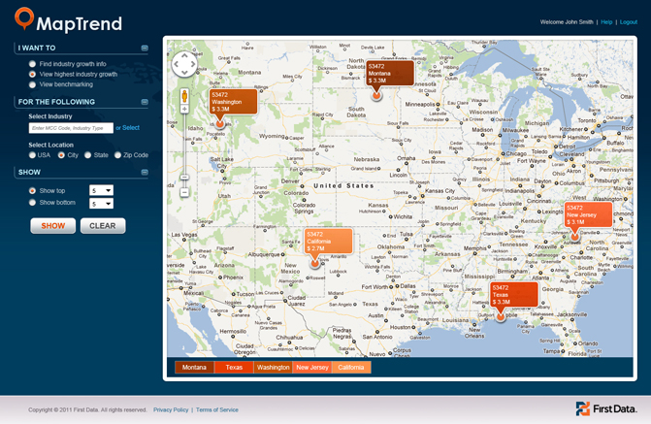
Our Recent Works
7
First Data MapTrend
MapTrend is a First Data product which provides its users with insightful rich information on geographic and domain specific performance of particular industries or best performance trends over specified time periods, as well as compares their performance with their similar business peer groups.

Slide 36
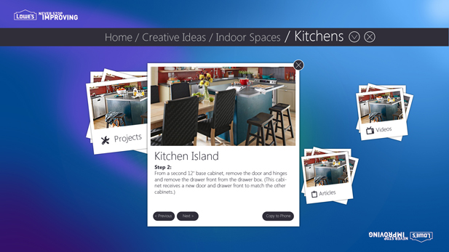
Our Recent Works
7
Inspiration MS Surface - Lowes
This customer engagement application was designed and proposed for Lowes - a leading chain of home need stores. The proposal was to build an engaging application that allows the users to explore the products and content of Lowes.

Slide 37
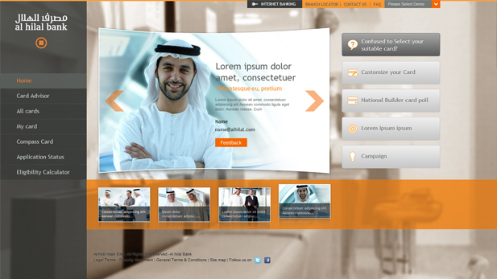
Our Recent Works
7
Al Hilal Bank
Al Hilal is a new generation Islamic bank which plans to launch this bank wide loyalty program application that provides the ability to recognize and reward customers, based on their relationship with the bank. The bank aims to make this loyalty program a differentiator in the market place and compete with the competition.

Slide 38
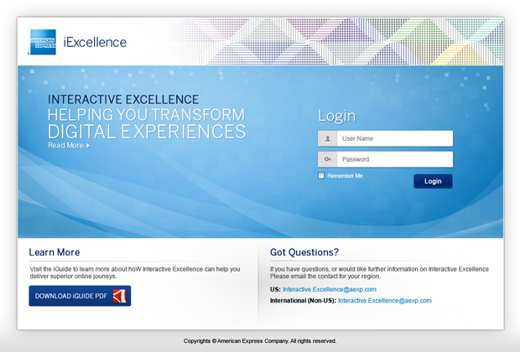
Our Recent Works
7
Interactive Excellence - Amex
iExcellence is an internal tool that helps to review interactive projects to ensure they follow the Interactive Guidelines (iGuide). Any new project that gets started in Amex based on the complexity and duration they will be governed by this tool. Business managers/ Project Mangers will key in the new project details in this tool providing details on projects estimates, channels supported, costing, deadlines, etc..

Slide 39
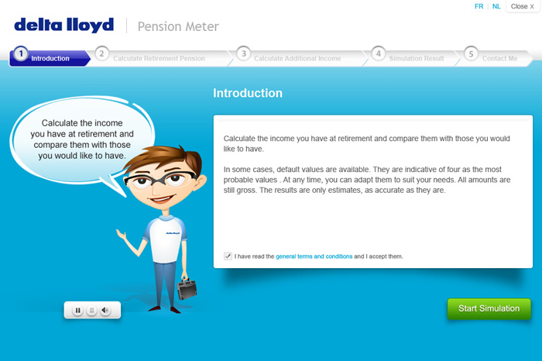
Our Recent Works
7
Pension Gap Simulator - Delta Lloyd Life
Pension Gap Simulator is a tool to be used by the public & brokers in Belgium to know their financial needs at the time of their pension to enjoy a comfortable retirement. The application supports various platforms - Flex, Smartphone and iPad. This tool is very unique on the Belgian market. And the animated character, called Fred, is very helpful for moving from one step of the simulation to another one within the application.
http://www.pensiometre.be/

Slide 40
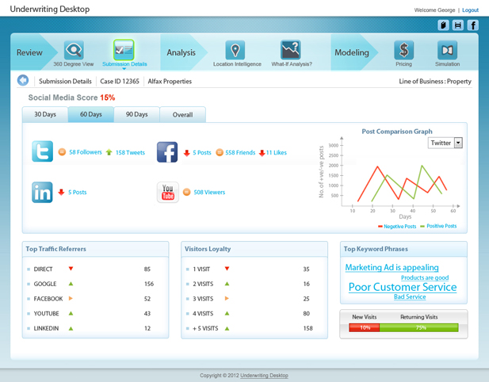
Our Recent Works
7
H3 Insurance - Cognizant
The H3 Insurance Future of Work is a conceptual and futuristic concept. This will enable commercial underwriters to focus on analyzing and pricing the risk and reduce unproductive tasks like data validation and preparation. The client is highly appreciative of our final deliverables.

Slide 41
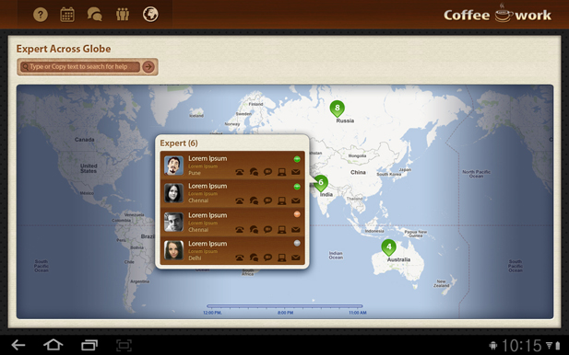
Our Recent Works
7
Coffee at Work
Coffee @t Work is prosperity application, an internal initiative by Cognizant. The visual design was started with the themes like casual, easy, warm, to demonstrate an easy workability through this application. However the visual designer put keen eyes to justify all visual elements harmoniously. Word map, the core attraction of this application shows the experts of respective domain available at that instance, to whom user can approach for help. This world map, depicting day & night is also helping to reduce the cultural differences.

Slide 42
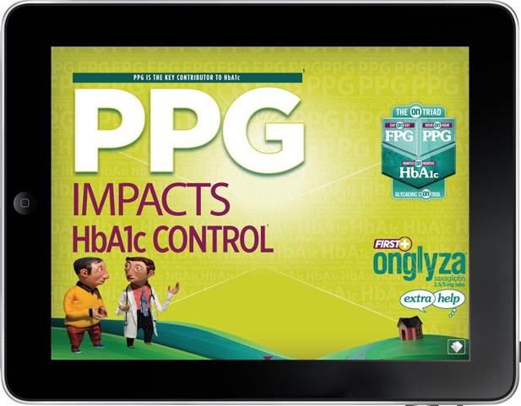
Our Recent Works
7
Onglyza - Astra Zeneca
This is an iPad application of AstraZeneca's Class A product - Onglyza. This application would be used by the Medical Representatives to showcase the product to the medical fraternity. This not only augments the brand identity but also creates a unique client and medical fraternity engagement. Interactivity, a key feature would enable the client to capture unique data for each visit to the doctor and capture real time data.

Slide 43
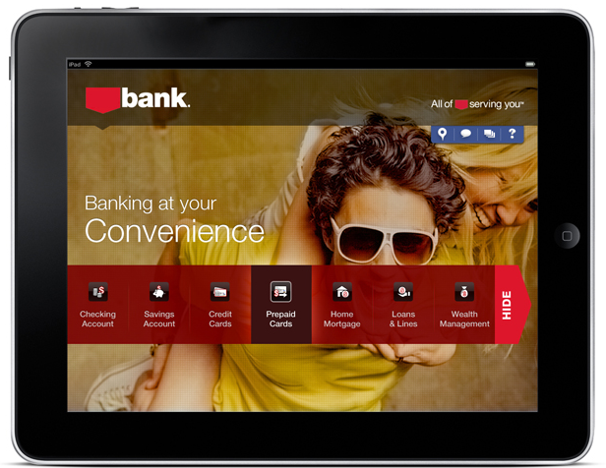
Our Recent Works
7
Leading Private Bank in US
Design explorations for a leading bank in the US. Prior to engaging with Cognizant Interactive, client had engaged with 2 other local design agencies. However, we built design credibility in this account by showcasing these design explorations. The designs were created for the banks micro site catering to Checking Account and Credit Accounts and one option where we had highlighted all the services offered. The users used this app to get the necessary information required for choosing a particular service. The target audience being the younger generation and young families that would be using the iPad, similar stock images were used to give it that young and trendy feel.

Slide 44
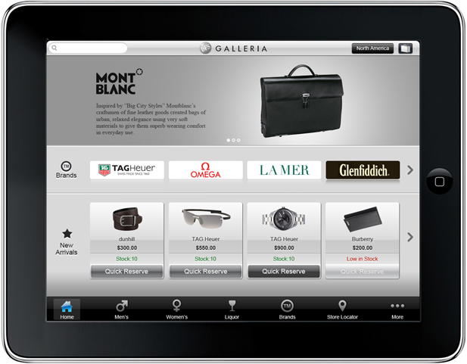
Our Recent Works
7
iPad App - DFS Mobile Store
DFS Mobile Store iPad app is an in-store application designed entirely by CI to take the DFS shopping experience to the next level. Customers can select/ review/ purchase products using the iPad. The application provides detailed description/specs for all their listed products.

Slide 45
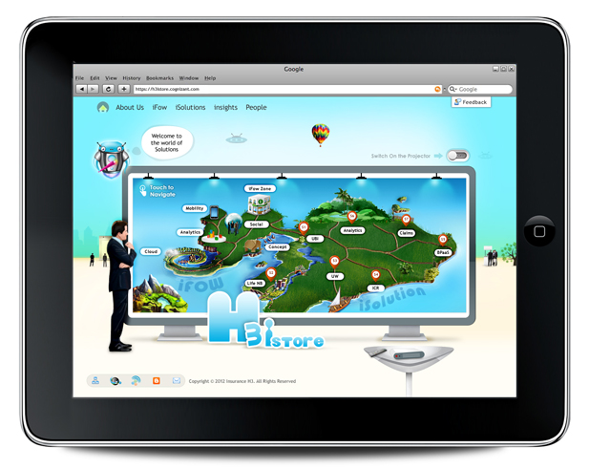
Our Recent Works
7
iStore - H3
The H3 iStore is an iPad/desktop microsite, with a rich UI which has a theme of a market place to showcase H3 insurance team's capabilities and their products to their clients. The client is impressed and appreciated the creative output.

Slide 46
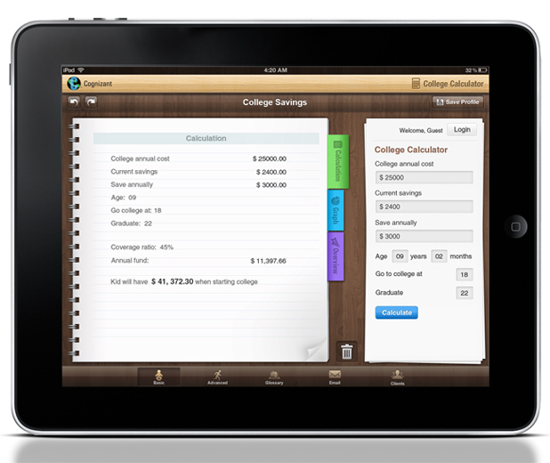
Our Recent Works
7
College Fee Calculator
This iPad native application calculates and compares the college fees to suit the user and help the user to pick up the right college. It will also help the user plan their savings for education. The application UI has the features: minimalistic design, sophisticated colors, task driven approach and suitable for both generations - parents and students.

Slide 47
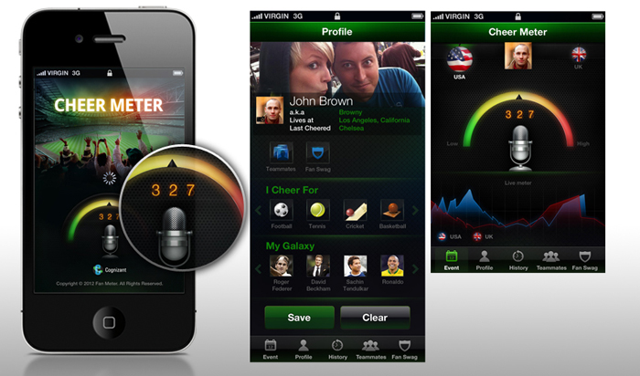
Our Recent Works
7
Cheer Meter App
The Cognizant IME vertical came up with a very novel idea of extending the stadium experience to home viewers. A demo of this application was essential to bring this concept to the market. Cognizant Interactive (CI) was chosen as the design team for the same with the typical brief of "we want that wow factor" and when CI delivered, the vertical team was indeed wowed and everyone including Patricia Angela and IME consulting were happy and satisfied with the efforts.

Slide 48
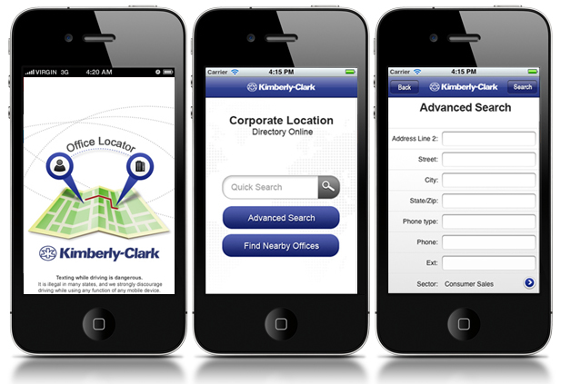
Our Recent Works
7
iPhoneApp - Office Locator
“Office Locator” is an IPhone App designed for Kimberly Clark. This was mainly to help Kimberly Clark (KC) clients and their officials to locate KC offices all over the world while traveling. They can easily locate the nearby offices or can search for a particular office in a particular place.

Slide 49
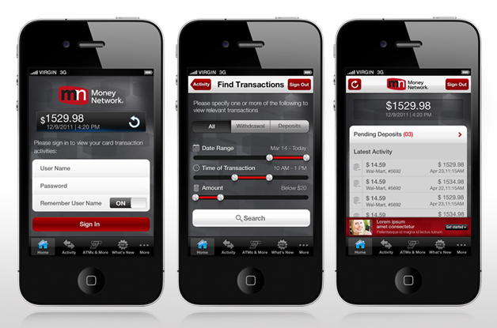
Our Recent Works
7
Money Network App - First Data
The project involves creating of mobile channels and corresponding native applications targeted at users of Money Network cards for account management – both on iOS & Android platforms. The project mainly aims at increasing adoption rate, improving brand experience, and reducing customer service costs via SMS or calls by pushing self-serve features through the application.

Slide 50
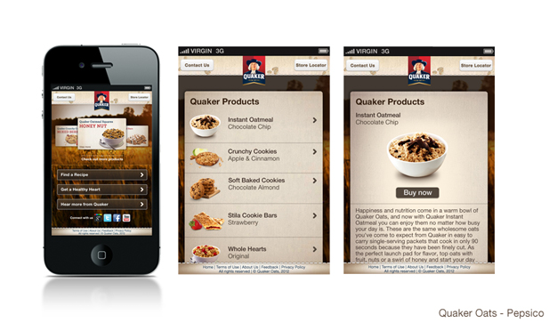
Our Recent Works
7
Quaker Oats - PepsiCo
In order to create their presence in the growing mobile domain, Quaker wanted to design a mobile website for Quaker Oats. Complimenting the current online website but also enabling users to interact with QuakerOats.com on-the-go and in-store. The mobile website has key features like product search and details, recipe search and Healthy living etc.

Slide 51
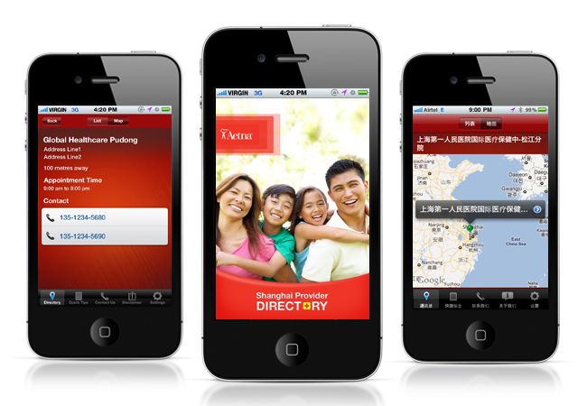
Our Recent Works
7
Aetna - Provider Directory
Aetna International Provider Directory is an iPhone & Android multi-geo, search-on-the-go application fitted with basic information for locating providers, filing claims and know the updated status. The tool was initially developed for China, resulting in high acceptance and was later adopted for other regions like Canada, Europe, Middle East and Hong Kong. The regional specific visual themes were created to give a unique localized flavor. It also has a local language version for ease-of-use.

Slide 52
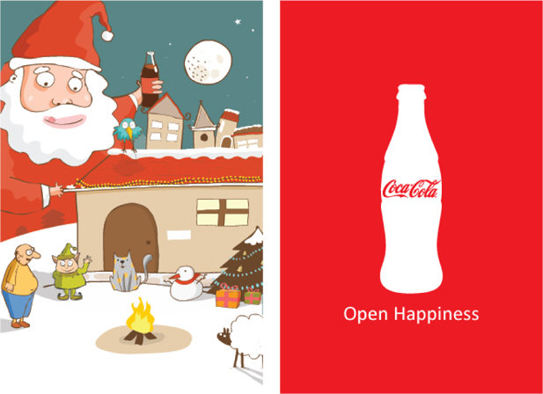
Our Recent Works
7
Coke Ad Campaign - Google
This is a Mobile based Christmas ad campaign. The landing page is more of a discovery. The user taps the hot spot in the composition and is lead to the next scene where Santa opens a bottle of Coke and sends his well wishes to the earth. The cap of the bottle travels collecting goodies that make up a Merry Christmas. At last the user ends up in home where everything is all set for the night. Santa rises in the background holding the bottle of Coke and smiles.

Slide 53
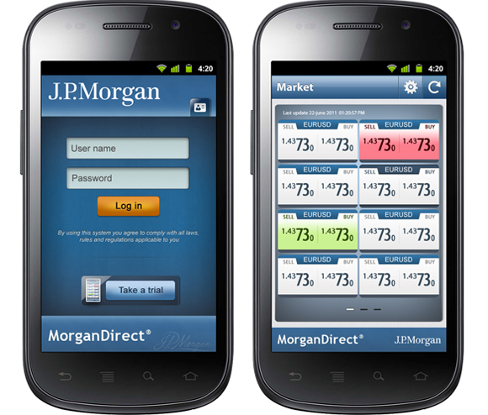
Our Recent Works
7
MorganDirect - JPMorgan
MorganDirect is an e-trading service from JPMorgan which powers to efficiently execute Foreign Exchange transactions. An outstanding industry standard GUI, balancing business goals and user expectations was delivered which enhanced business traction. It was recognized in 2012 as Digital Fx Awards by Profit & Loss Magazine as BEST MOBILE PLATFORM AWARD.

Slide 54
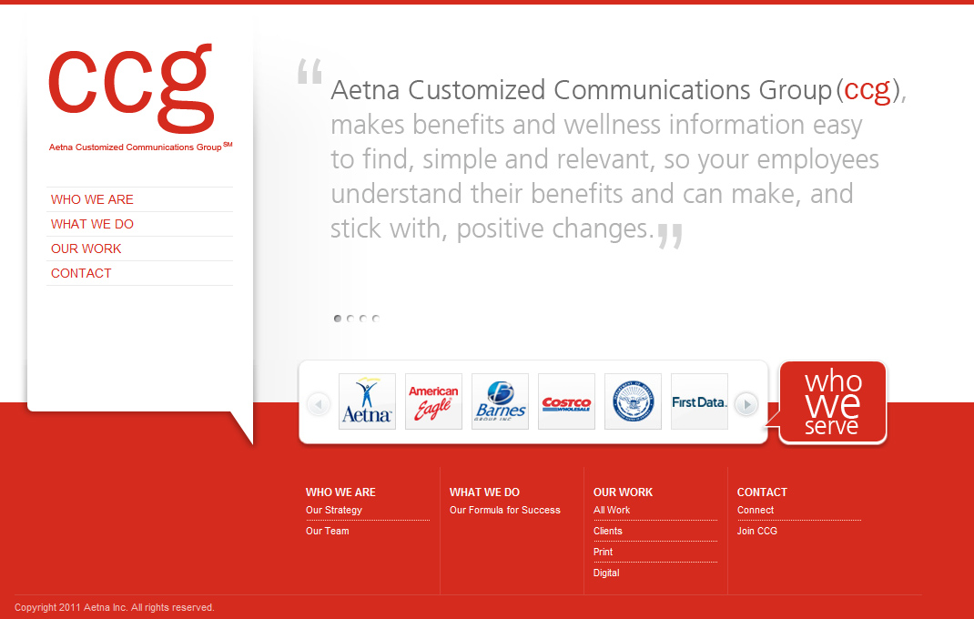
Our Recent Works
7
Aetna CCG Website Redesign
The previous website of CCG was more like a printed piece. The new website has been given a unique, fresh and new look, at the same time Client brand guidelines are maintained. The website has neat, simple, yet impactful presentation which compliments the user experience. It also reflects the intuitive, engaging, simple, attractive & informative nature of the new website.
www.aetnaccg.com

Slide 55
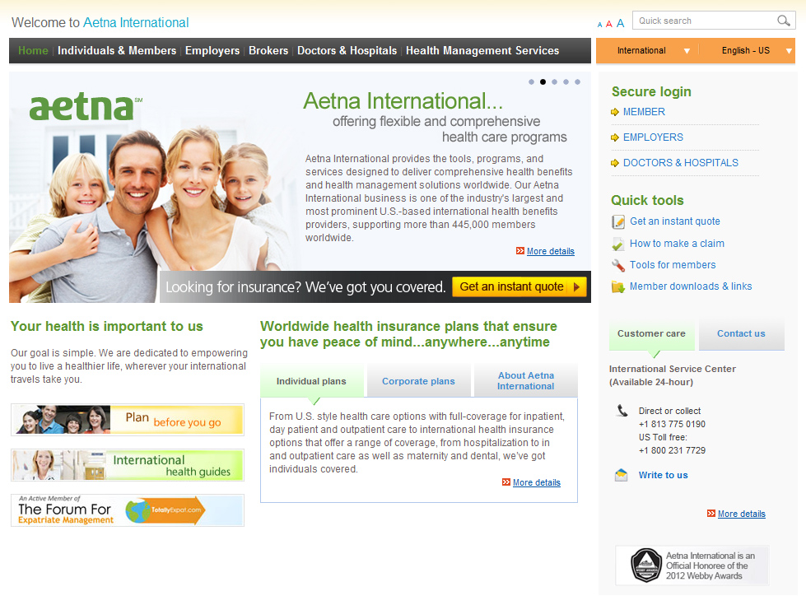
Our Recent Works
7
Aetna International Web Strategy
Aetna International plans to make significant enhancements to their Web capabilities in order to establish and retain their leadership position in the international healthcare market while expanding their expatriate and health management services business and as part of this globalization strategy.
www.aetnainternational.com

Slide 56
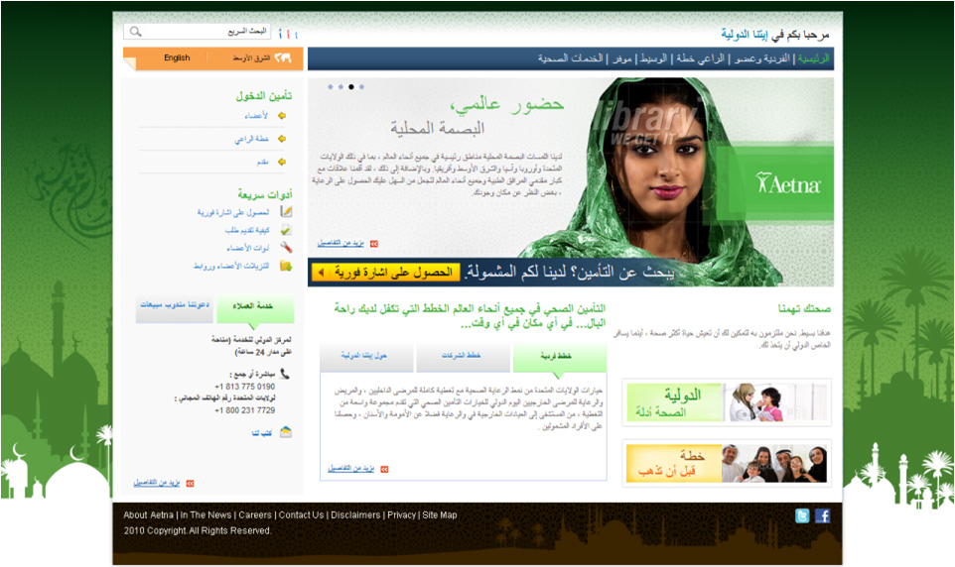
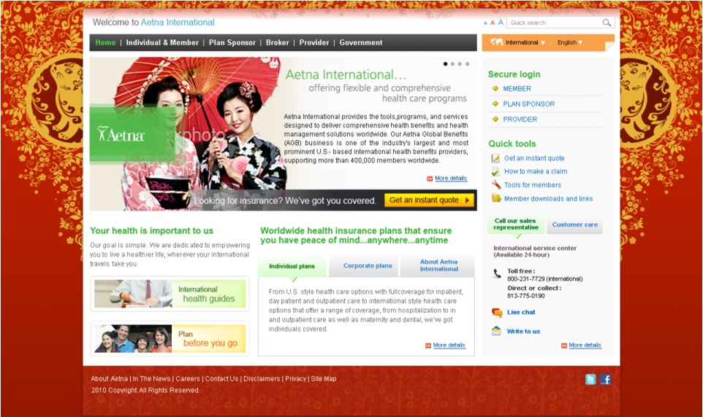
Our Recent Works
7

Slide 57
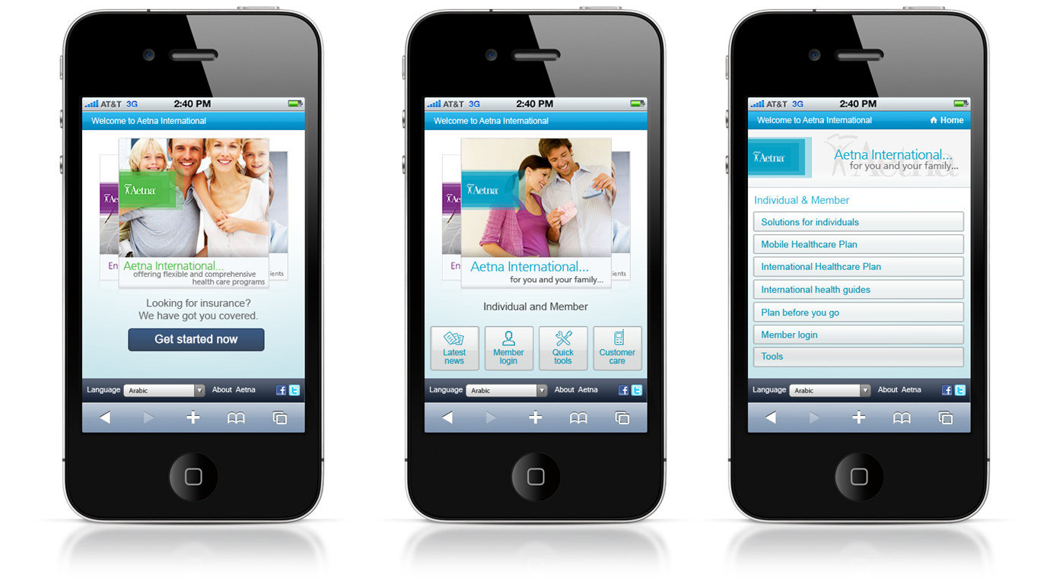
Our Recent Works
7

Slide 58
Coming together is a beginning. Keeping together is progress. Working together is success. -Henry Ford
“
“

